Slide 1
Valuation of Bonds and Shares (Application of TVM)
Dr. Sarveshwar Kumar Inani
sarveshwarinani@wilp.bits-pilani.ac.in

Slide 2
Agenda
Explain the fundamental characteristics of ordinary shares, preference shares and bonds (or debentures).
Show the use of the present value concepts in the valuation of shares and bonds.
Valuation of Bonds
Valuation Preference Shares
Valuation of Equity Shares

Slide 3
Features of a Bond (Or debenture)
Long-term debt instrument or security.
Interest Rate or coupon rate is fixed
Face Value or par value of Rs 100 or Rs 1,000, and interest is paid on face value.
Maturity is fixed.
Redemption value - may be redeemed at par or premium.
Market Value- may be different from par value or redemption value as it is traded in the market.

Slide 4
Types of Bonds
Bonds with maturity
Pure discount bonds -The bond discount is the difference between the par value and the selling price.
Perpetual bonds

Slide 5
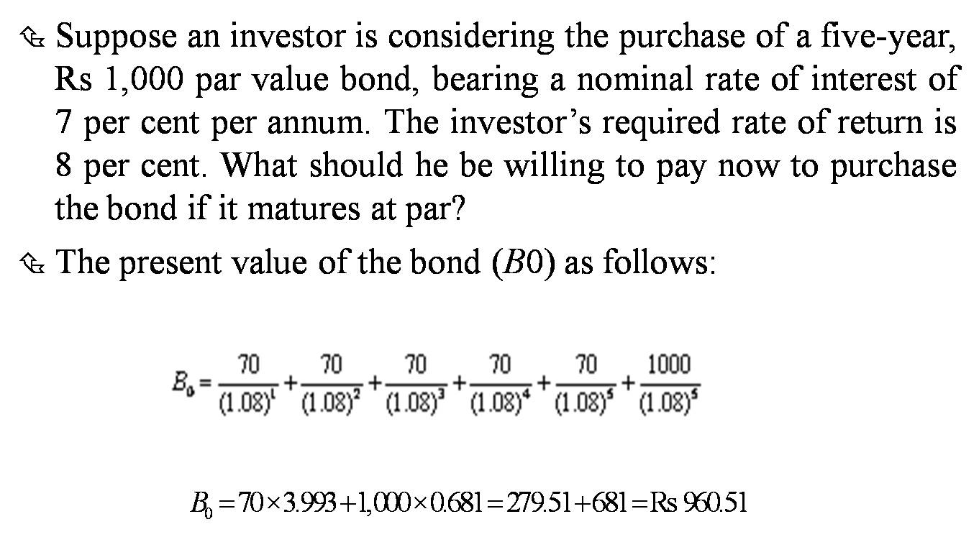
Valuation of Bond with Maturity
Bond Value = PV of all annual interest payments + PV of Maturity value
Example (Do the calculation):
(Source: Numerical examples taken from the Book I.M. Pandey)

Slide 6
Yield to Maturity (YTM)
YTM is the measure of bond’s rate of return which considers both the annual interest income and any capital gain or loss.
YTM is bond’s internal rate of return.
YTM can be computed using EXCEL function or calculator.
Or it can be computed using trial and error method (manually).
Explain with the help of previous slide example.

Slide 7
Current Yield
Current yield is the annual interest divided by the bond’s current value.
Example: The annual interest is Rs 60 on the current investment of Rs 883.40. Therefore, the current rate of return or the current yield is: 60/883.40 = 6.8 per cent.
Current yield does not account for the capital gain or loss.

Slide 8
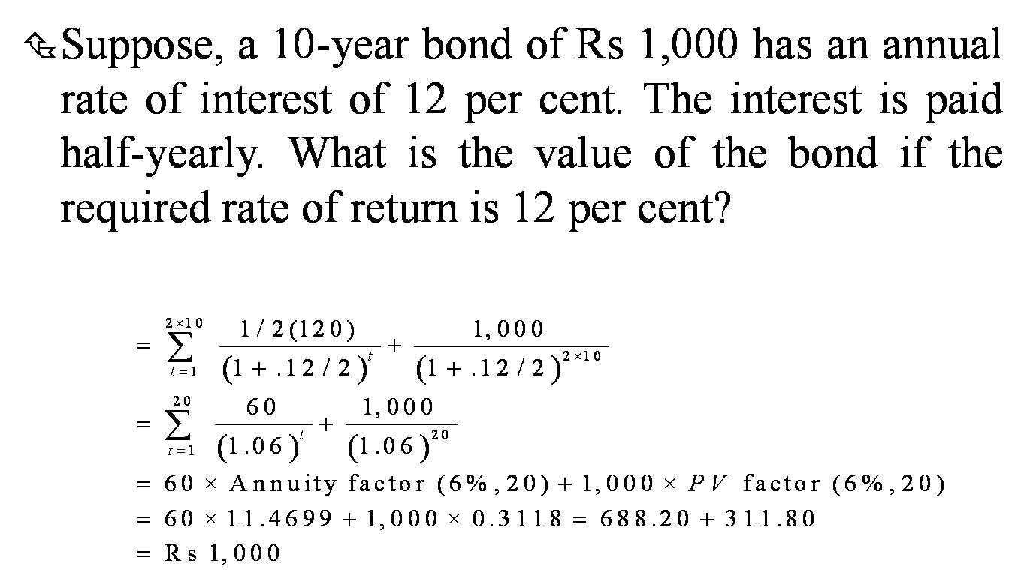
Bond Values and Semi-annual Interest Payments

Slide 9
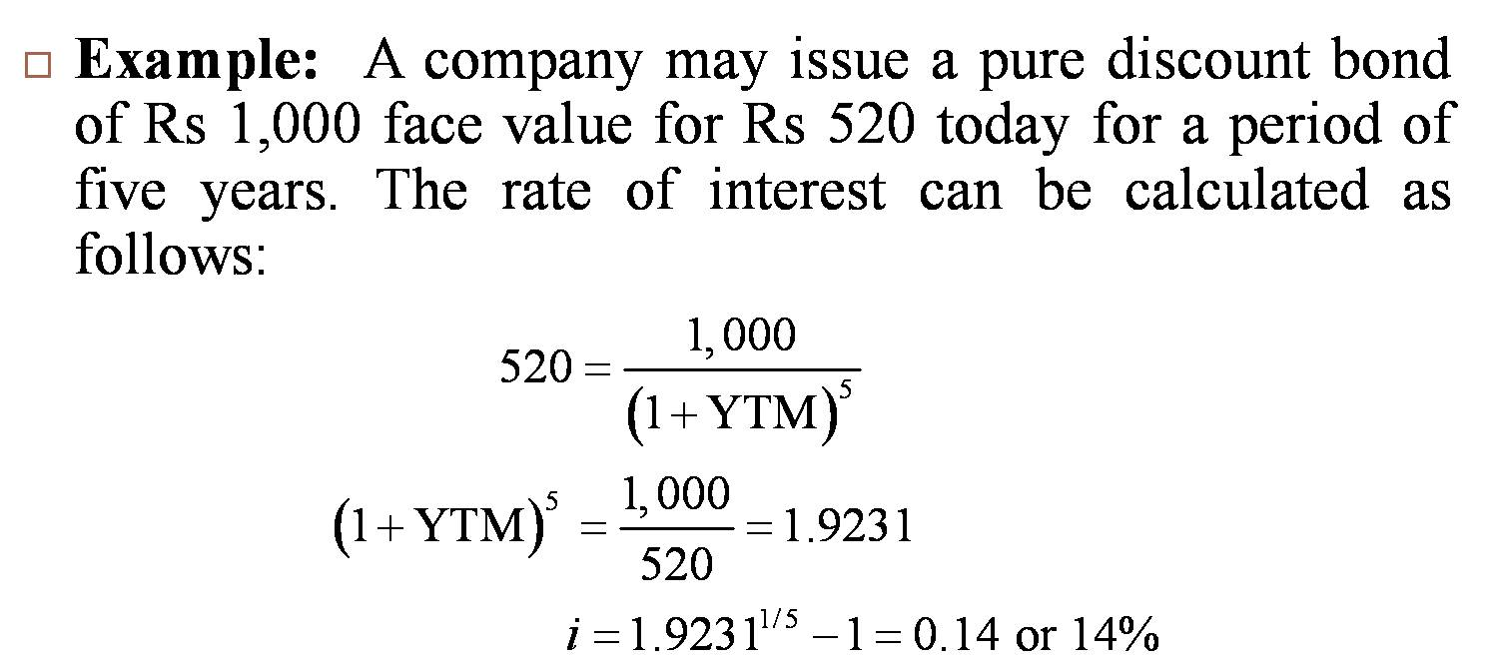
Pure Discount Bonds (Zero Coupon Bonds)
Pure discount bond do not carry an explicit rate of interest.
It provides for the payment of a lump sum amount at a future date in exchange for the current price of the bond.
The difference between the face value of the bond and its purchase price gives the return or YTM to the investor.

Slide 10
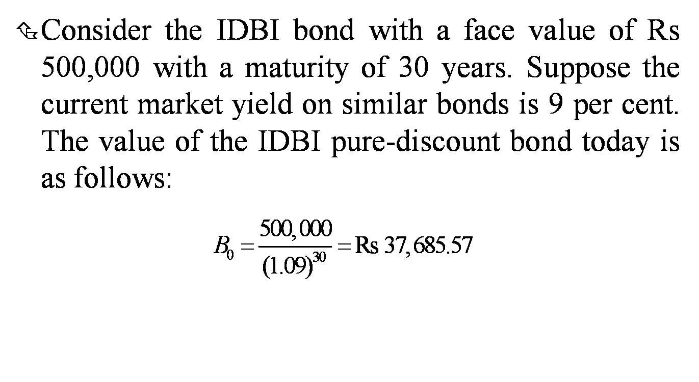
Example

Slide 11
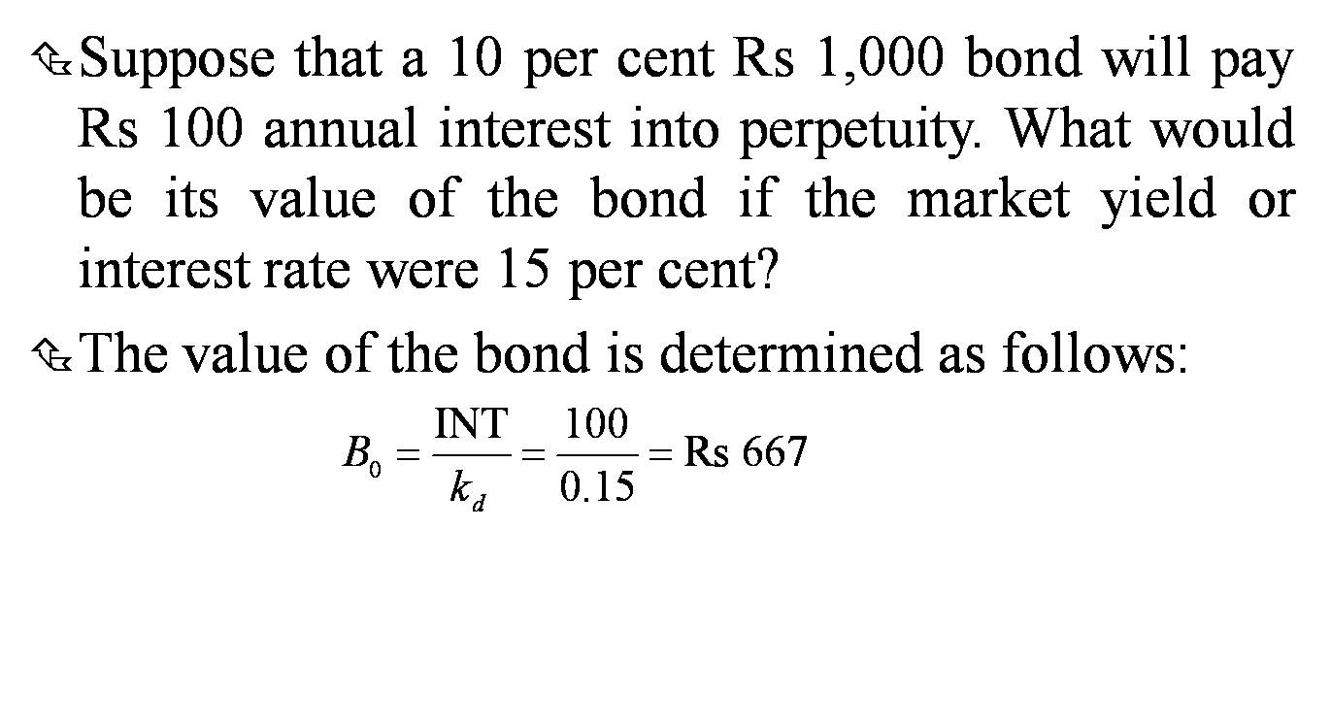
Perpetual Bonds
No maturity (infinite life). An example of perpetuity. Rarely found in practice.

Slide 12
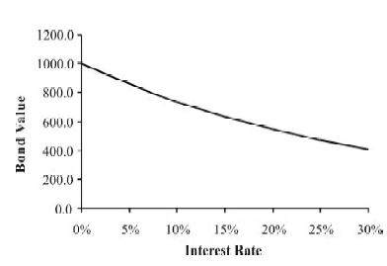
Bond Values and Changes in Interest Rates
The value of the bond declines as the market interest rate (discount rate) increases.
The value of a 10-year, 12 per cent Rs 1,000 bond for the market interest rates ranging from 0 per cent to 30 per cent is shown in the figure.

Slide 13
Default Risk and Credit Rating
Default risk is the risk that a company will default on its promised obligations to bondholders.
Default premium is the spread between the promised return on a corporate bond and the return on a government bond with same maturity.
Rating agencies (CRISIL, ICRA, CARE)

Slide 14
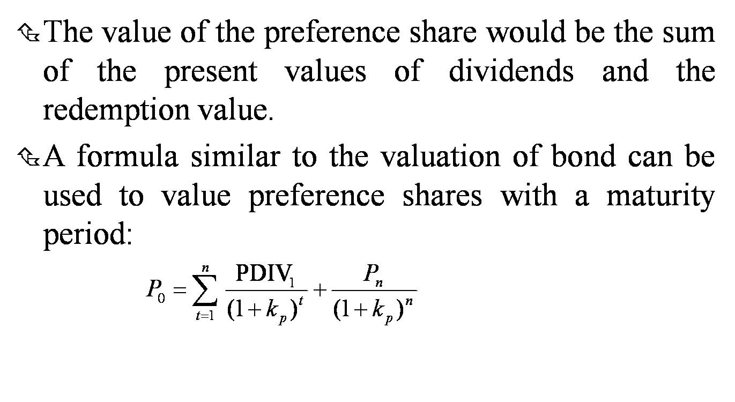
Valuation of Preference Shares (Same process as bonds)

Slide 15
Valuation of Ordinary Shares
The valuation of ordinary or equity shares is relatively more difficult.
The rate of dividend on equity shares is not known; also, the payment of equity dividend is discretionary.
The earnings and dividends on equity shares are generally expected to grow, unlike the interest on bonds and preference dividend.

Slide 16
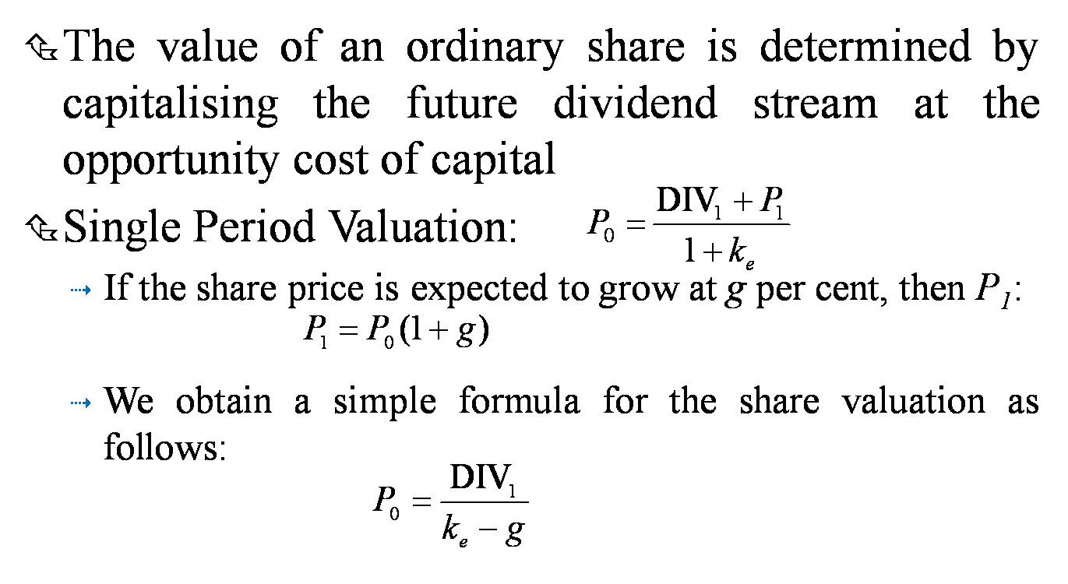
Dividend Capitalisation

Slide 17
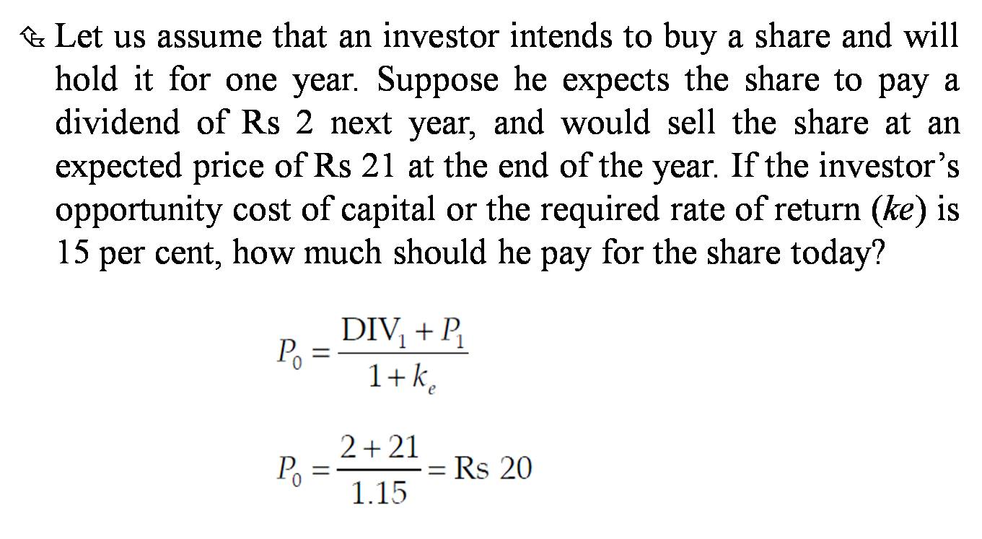
Example- Single Period Valuation

Slide 18
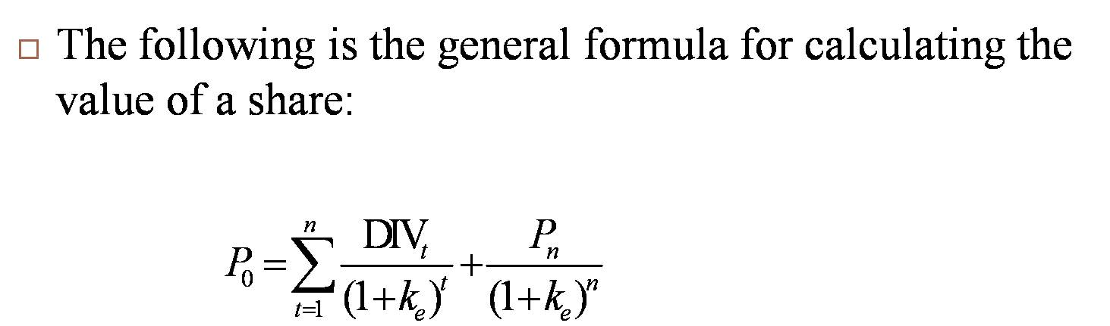
Multi-period Valuation

Slide 19
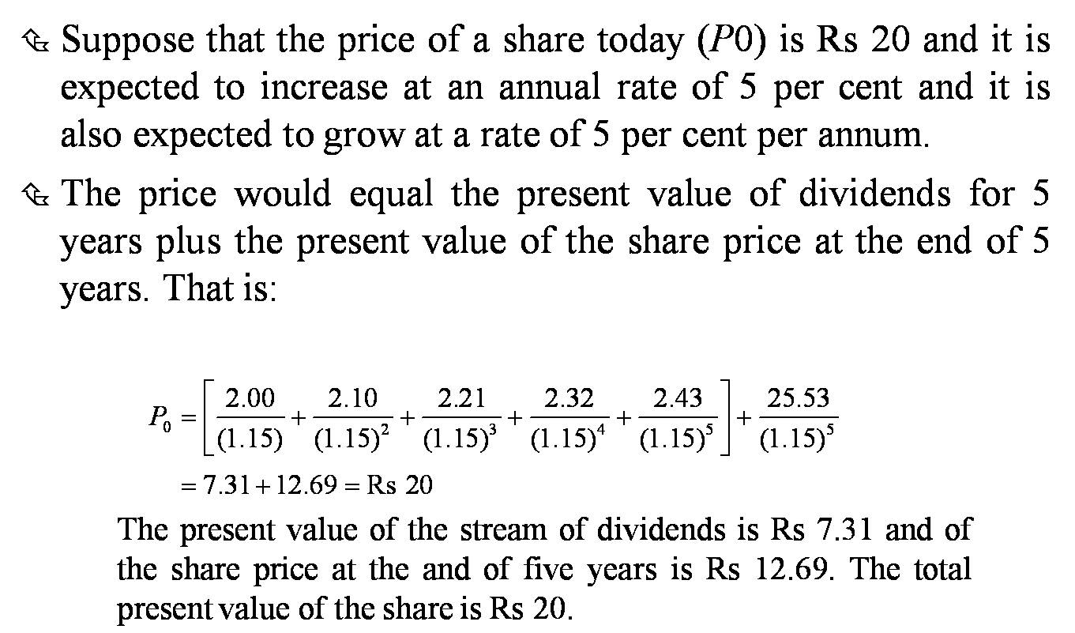
Example: Multi-period Valuation

Slide 20
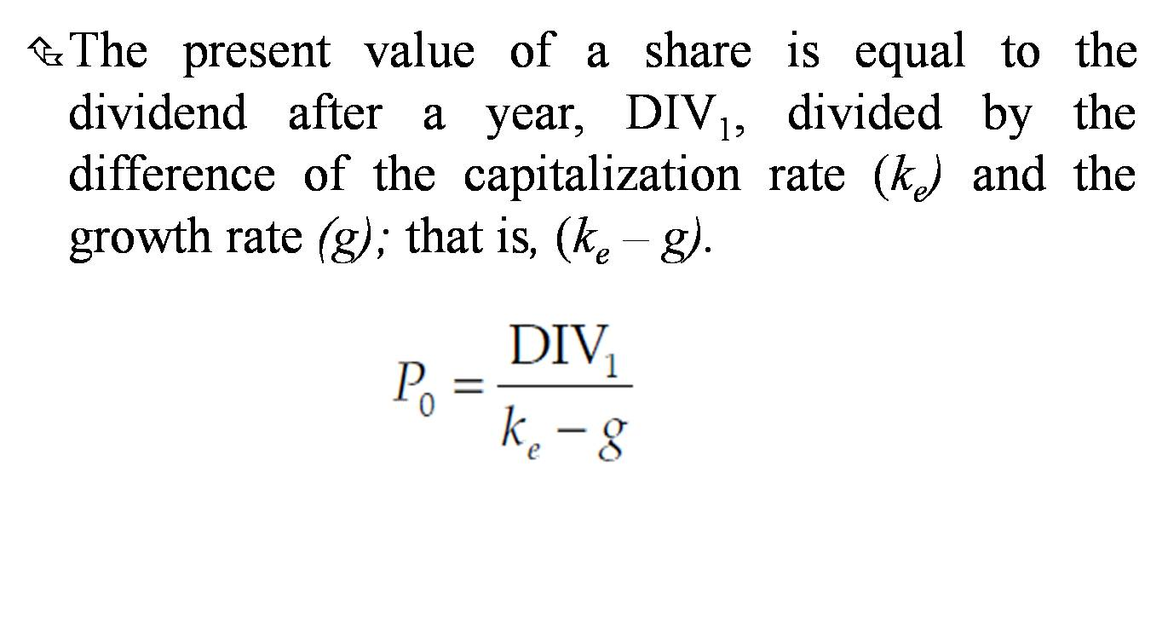
Perpetual Growth Model

Slide 21
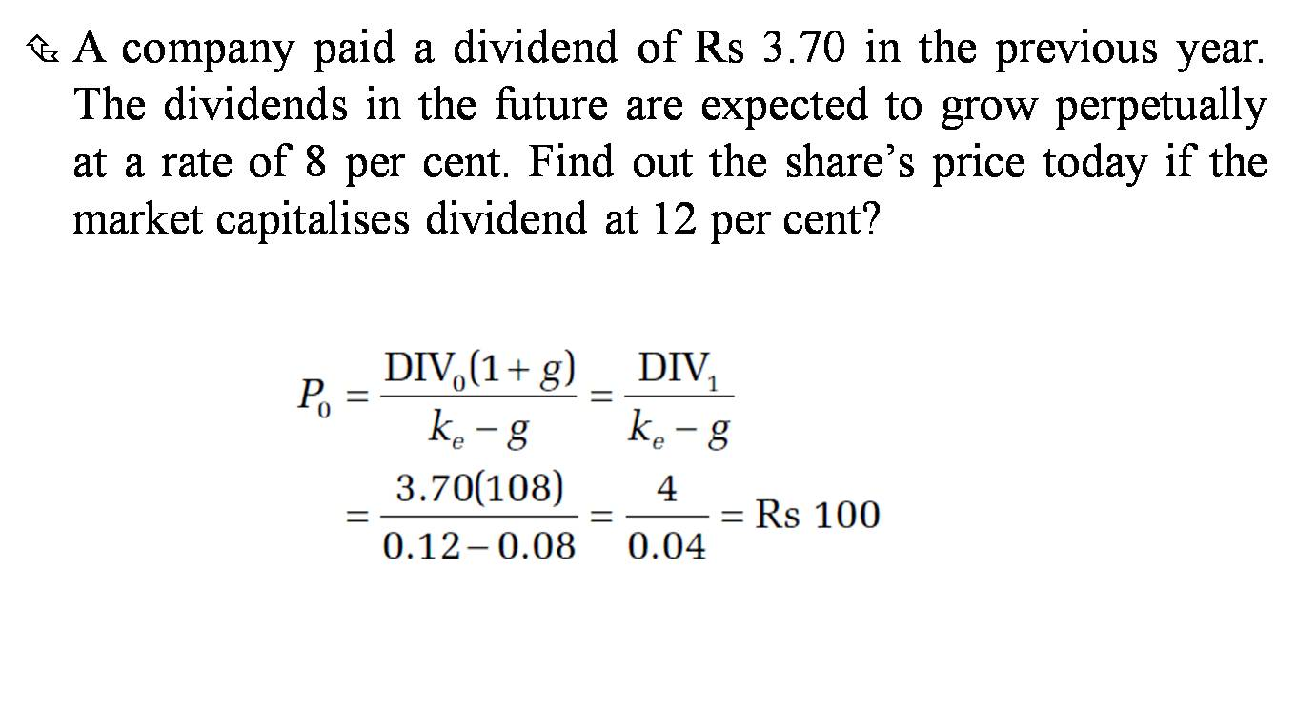
Example: Perpetual Growth

Slide 22
Discounted Cash Flow Model
Discounted cash flow (DCF) refers to a valuation method that estimates the value of an investment using its expected future cash flows.
Estimate firm’s expected cash flow for next 10 years.
Estimate growth rate and compute Terminal value of infinite cash flow series after 10th year (going concern)
Decide opportunity cost of capital.
So many forecasts are involved. Very tricky.

Slide 23
Practice Questions
Q1. You intend to purchase a 15-year, $1,000-par-value bond that has a coupon rate of 9%.If your required return is 10%, what is the value of this bond? If the current market price for this bond is $985, should you purchase this bond? (PV of Coupons 684.54+PV of Maturity value 239.39= Total 923.93, Overvalued in market, Not buy)

Slide 24
Practice Questions
Q2. A Rs 100 perpetual bond is currently selling at INR 95. The coupon rate is 13.5%, and required rate of return is 15%. Compute the value of bond. should you purchase this bond? What is YTM? (Value = INR 90, Overvalued in market, Not buy, YTM=14.21%)

Slide 25
Practice Questions
Q3. A company expects to pay a dividend of INR 7 next year, which is expected to grow at 6%. Assume the required rate of return is 10%. Compute the price of the share with dividend growth model. (given Div1=7, r=0.10, g=0.06) (Solution=INR 175)

Slide 26
THANK YOU!!!

